Slide 1
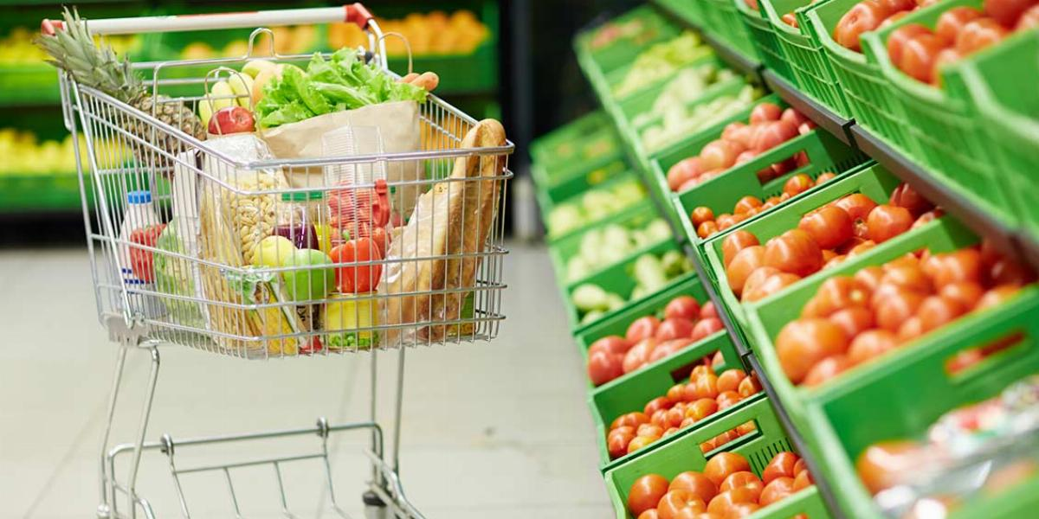
Market Basket Analysis
March 19, 2021
Anupama r.k, Queenie Tsang, Crystal (Yunan) Zhu

Slide 2
Business case
Notes:
reduces a customer’s shopping time,
reminds the customer of what relevant items (s)he might be interested in buying,
helping stores cross-sell in the process

Slide 3
Association rule
List of items with the same order ID are studied as a group – user information will not be taken into consideration.
Metrics to measure the strength of the rules
Support: how frequent an itemset is in all the transactions – value we use: 0.0015 (the itemset should occur in at least 0.15% of all transactions)
Confidence: the likeliness of occurrence of consequent on the cart given that the cart already has the antecedents – value we use: 0.4
Note: The confidence for an association rule having a very frequent consequent will always be high
Lift: the rise of the confidence that {X} provides to us for having {Y} on the cart (whether X increases the chance of buying Y).
Lift is the measure that will help store managers to decide product placements on aisle.
Notes:
Apriori - All subsets of a frequent itemset must also be frequent - if we drop out an item from an itemset, support value of new itemset generated will either be the same or will increase.
Apriori principle allows us to prune all the supersets of an itemset which does not satisfy the minimum threshold condition for support. For example, if {Milk, Notebook} does not satisfy our threshold of minsup, an itemset with any item added to this will never cross the threshold too.
Pruning of infrequent itemsets could reduce the number of itemsets to be considered by more than half!

Slide 4
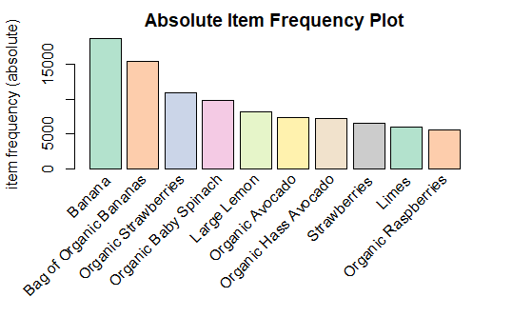
Association rule
In total,131,209 unique orders and 39,123 unique product names
We chose the top 50 products to mine the rules
Less frequently bought items have less chance of appearing in any rules
Less frequently bought items will not affect the rules much

Slide 5
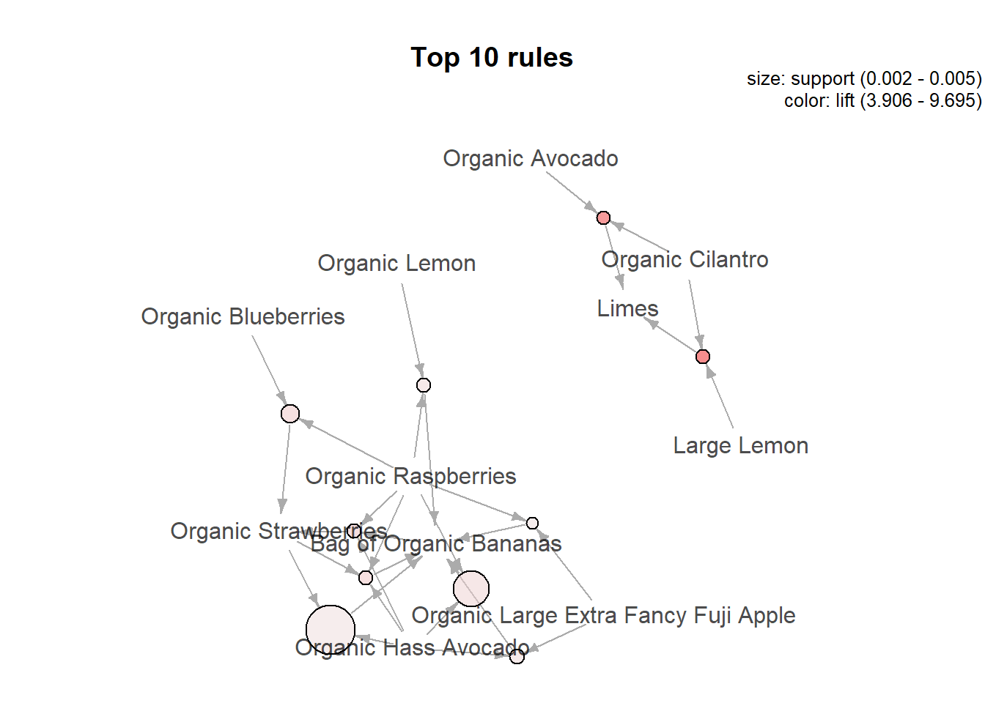
Mined rules
Sample rules
lhs |  | rhs | support | confidence | lift
{Broccoli Crown, Organic Avocado} | => | {Banana} | 0.0015 | 0.419 | 2.935
{Organic Lemon, Organic Raspberries} | => | {Bag of Organic Bananas} | 0.0017 | 0.499 | 4.229

